Slide 1
Unit 5-3 Bisectors in Triangles
PLANE Geometry

Slide 2
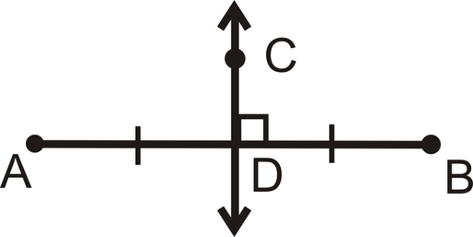
Perpendicular Bisector
$$\overset{⃡}{CD} is the Perpendicular Bisector of \overline{AB}$$

Slide 3
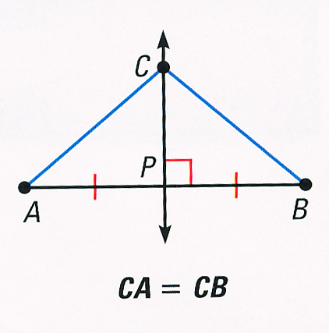
Perpendicular Bisector Theorem:
If a point is on the perpendicular bisector of a segment, then it is equidistant from the endpoints of the segment.

Slide 4
Converse of the Perpendicular Bisector Theorem:
If a point is equidistant from the endpoints of a segment, then it is on the perpendicular bisector of the segment.

Slide 5
Example 1:
$\overset{⃡}{CD}$ is the perpendicular bisector of $\overline{AB}$. Find CA and DB.
$$C$$
$$5$$
$$A$$
$$B$$
$$E$$
$$6$$
$$D$$

Slide 6
Example 2:
$\overline{CD}$ is the perpendicular bisector of $\overline{AB}$. Find x, CA, and CB.
$$C$$
2$x+9$
$$4x−3$$
$$A$$
$$B$$
$$D$$

Slide 7
Angle Bisector Theorem:
If a point is on the bisector of an angle, then the point is equidistant from the sides of the angle.
Converse of the Angle Bisector Theorem:
If a point in the interior of an angle is equidistant from the sides of the angle, then the point is on the angle bisector.

Slide 8
Example 3:
$\overline{CD}$ is the Angle Bisector. Find x, CA, and CB.
$$A$$
$$3x−8$$
$$D$$
$$C$$
$$2x+5$$
$$B$$

Slide 9
Isosceles Triangles and Angle Bisectors
The bisector of the vertex angle of an isosceles triangle is the perpendicular bisector of the base.
$$C$$
$$A$$
$$B$$
$$D$$

Slide 10
Example 4:
$\overline{MO}$ is the Angle Bisector. Find x and y.
M
y°
63°
x°
L
N
O

Slide 11
Example 5:
Is C on the Angle Bisector?
$$A$$
$$A$$
$$6$$
$$7$$
$$D$$
$$C$$
$$D$$
$$C$$
$$6$$
$$6$$
$$B$$
$$B$$

